Slide 1
AUTOMATIC
NUMBER PLATE RECOGNITION
Presented By:
M. Linnet Blessy-211419104147
B. Mathumita-211419104164
Guided By:
Dr.K. Sangeetha Krishnan ,M.E.,Ph.D.,
Associate Professsor

Slide 2
ABSTRACT:
Automatic number-plate recognition is a technology that uses optical character recognition on images to read vehicle registration plates to find out vehicle location data.
It can use existing closed-circuit television , road-rule enforcement cameras, or cameras specifically designed for the task.
ANPR is used by police forces around the world for law enforcement purposes, including to check if a vehicle is registered or liscensed .
Automatic number-plate recognition can be used to store the images captured by the cameras as well as the text from the license plate, with some configurable to store a photograph of the driver.
Systems commonly use infrared lighting to allow the camera to take the picture at any time of day or night .

Slide 3
introduction:
AUTOMATIC NUMBER PLATE RECOGNITION (ANPR) is using an Image Processing Technology which uses number (License) plate to identify the vehicle.
The objective is to design an efficient automatic authorized vehicle identification system by using the vehicle number plate.
The system is implemented on the tolls, highly restricted areas like military zones.
The developed system first detects the vehicle and then captures the vehicle image.
Vehicle number plate region is extracted using the image segmentation in an image.
Optical character recognition technique is used for the character recognition.
The resulting data is then used to compare with the records on the database so as to come up with the specific information like vehicles owner ,place of registration , address and etc.

Slide 4
Literature survey:
AUTHOR | PUBLISHED YEAR | SURVEY
Xiaojun Zhai, Faycal Bensaal | 2013 | Standard Definition ANPR System on FPGA and an Approach to Extend it to HD.
H. Erdinc Kocer and K. Kursat Cevik | 2011 | Artificial neural networks based vehicle license plate recognition.
A Roy and D.P Ghoshal | 2011 | Number Plate Recognition for use in different countries using an improved segmentation.
Anton Satria Prabuwono and Ariff Idris | 2008 | A Study of Car Park Control System Using Optical Character Recognition.
Jianbin Jiao, Qixiang Ye, and Qingming Huang | 2009 | A configurable method for multi-style license plate recognition.
Zhigang Zhang and Cong Wang | 2012 | The Research of Vehicle Plate Recognition Technical Based on BP Neural Network.
Ying Wen | 2011 | An Algorithm for License Plate recognition Applied to Intelligent Transportation System.
Yang Yang, Xuhui Gao, and Guowei Yang | 2011 | Study the Method of Vehicle License Locating Based on Color Segmentation.
M.A. Sotelo , J. Nuevo , L.M. Bergasa and M. Ocana | 2005 | Road Vehicle Recognition in Monocular Images.
Xiaojun Zhai, Faycal Bensaali and Reza Sotudeh | 2012 | OCR Based Neural Network for ANPR.

Slide 5
Problem statement:
It is seen that the security forces and authorities face problems whenever security forces chase a vehicle or they can’t catch a vehicle which broke traffic rules. Authorities find it very hectic on a busy day to log the vehicle numbers manually in a parking lot. So, in order to make the entire process autonomous, we can install this system so as to automatically detect the vehicle which breaks the traffic rules, take a picture of it and store the number in the database so as to fine the respective owner afterwards. The system can be used in parking so as to take the picture of the vehicle and log the vehicle number in the database (or the cloud, if connected to the internet).This technology reduces the unnecessary hectic manual work required on any busy day, saves the labour cost and is far more efficient than humans. The number of any vehicle once obtained as text, can be displayed, saved in the database or can be searched through the entire database for the details. This project is so versatile that it can be used as an entire application once converted to a software or can be used as a part of any big project.

Slide 6
Development environment:
Hardware Components:
Site cameras or Domes
ANPR Cameras
Client CCTV System
ANPR System
Gate or Barrier Control
Intercom/Audio Lighting Signage
Local Monitor

Slide 7
Software Components:
OpenCV 3
PIL
Python 3
Tensor Flow
MongoDB
Anaconda package manager
imutils

Slide 8
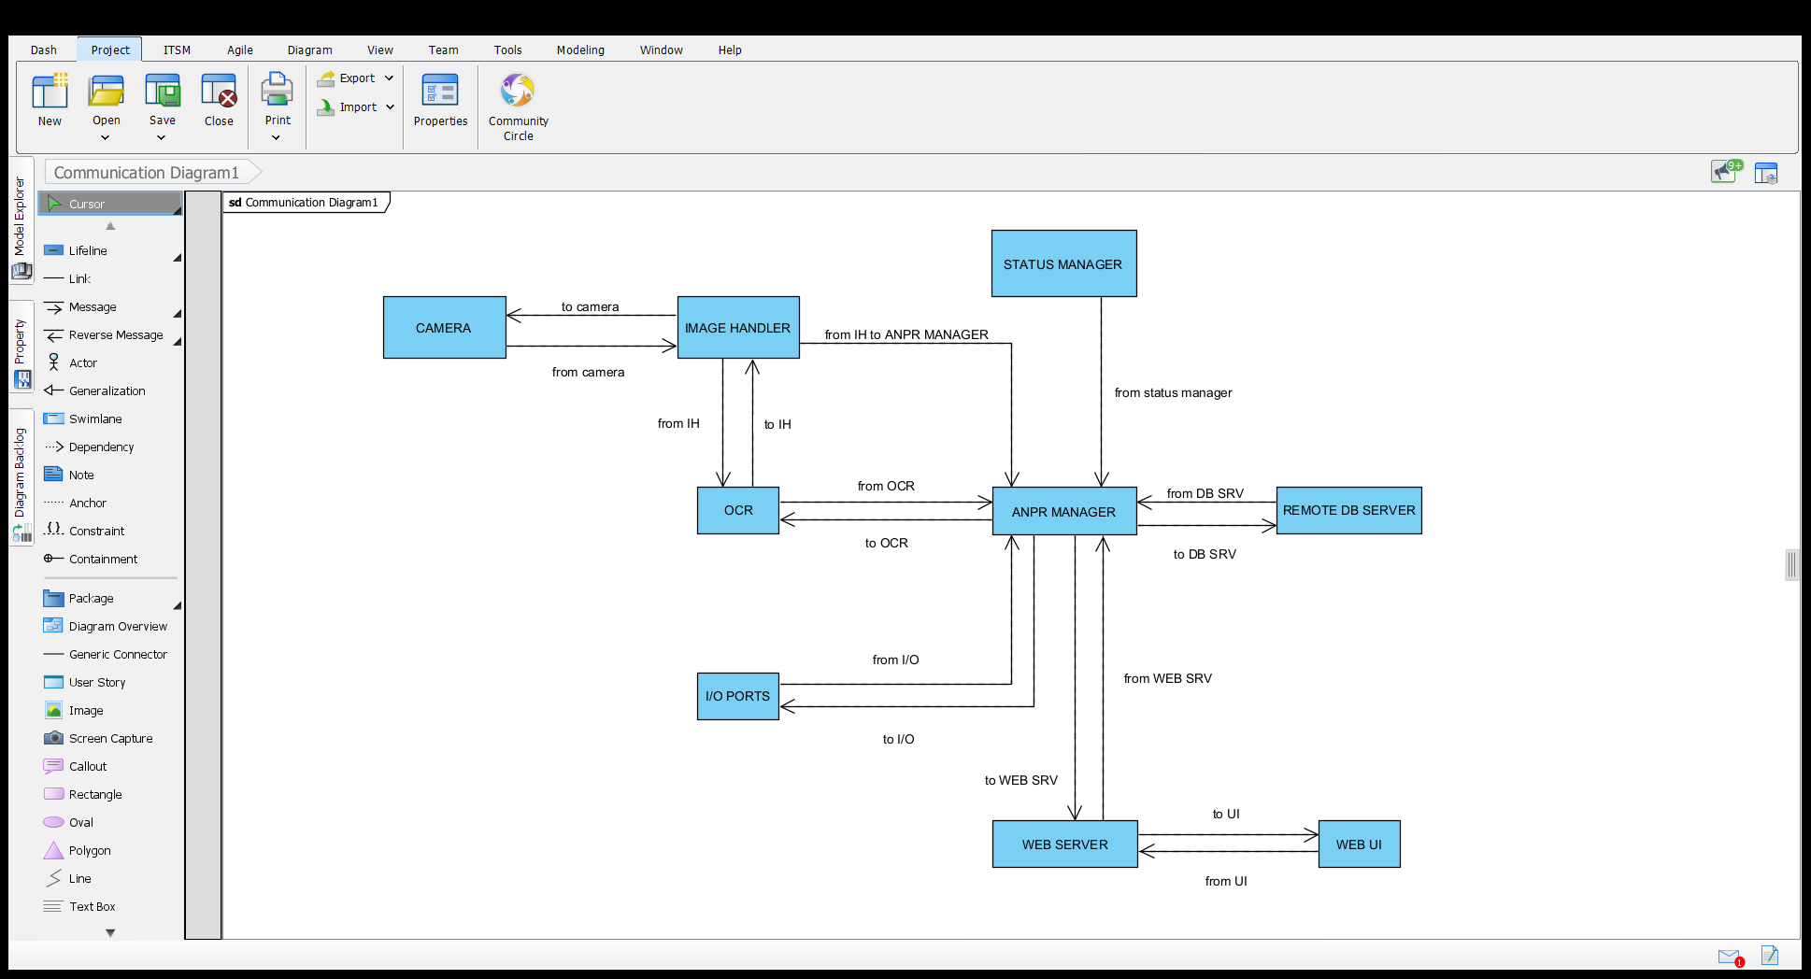
System architecture:

Slide 9
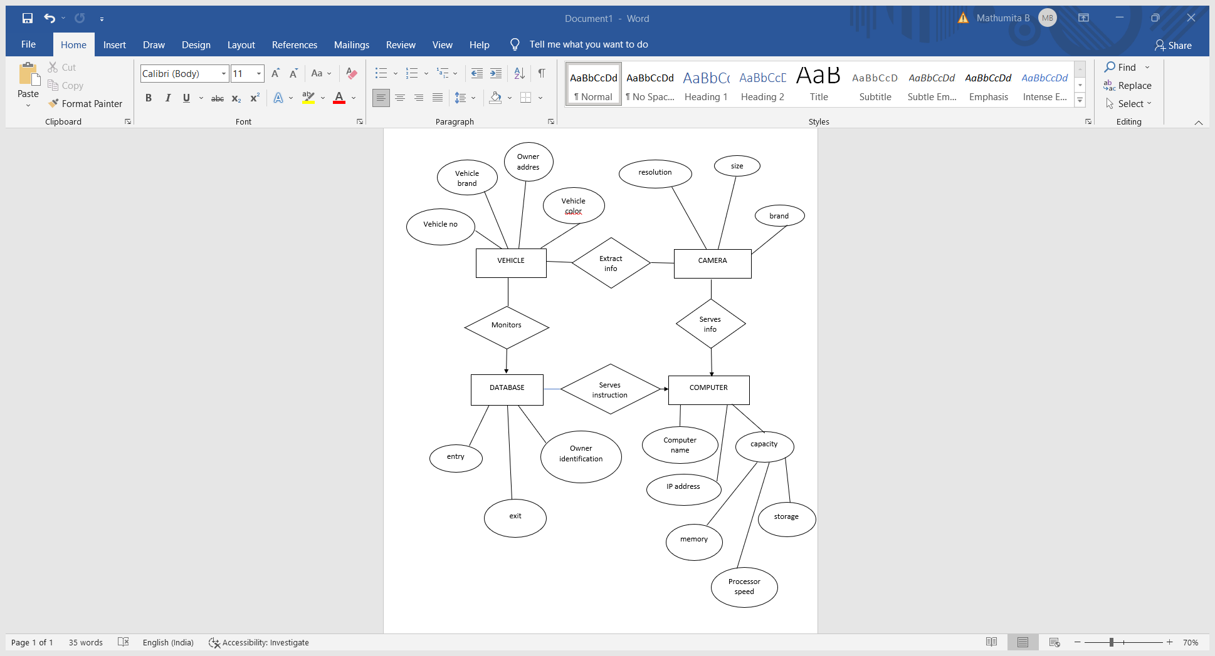
System design: ER DIAGRAM:

Slide 10
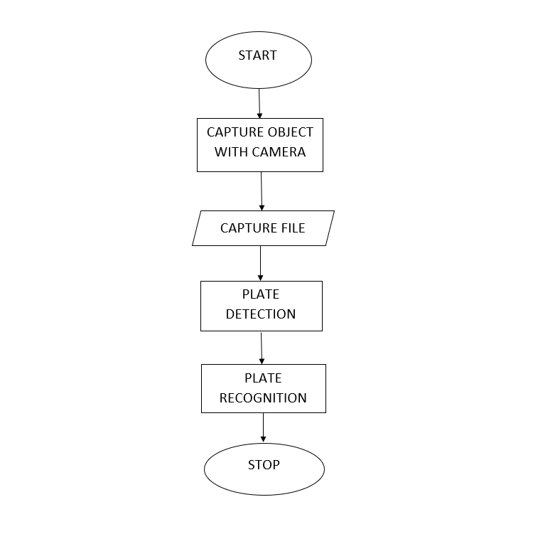
DATAFLOW DIAGRAM:

Slide 11
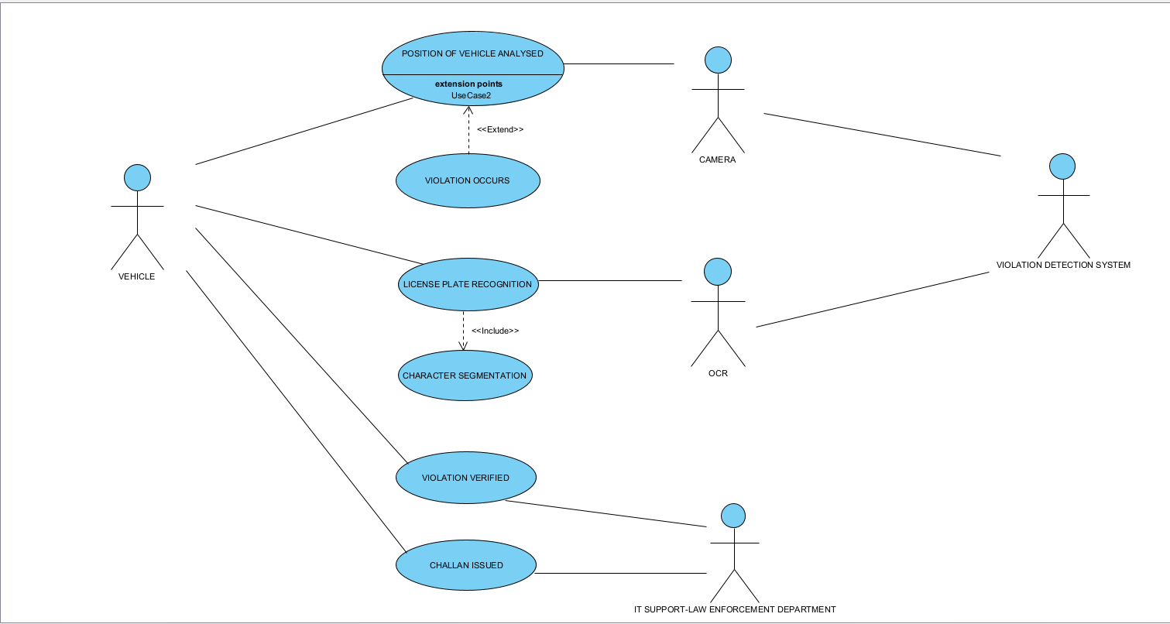
USE CASE DIAGRAM:

Slide 12
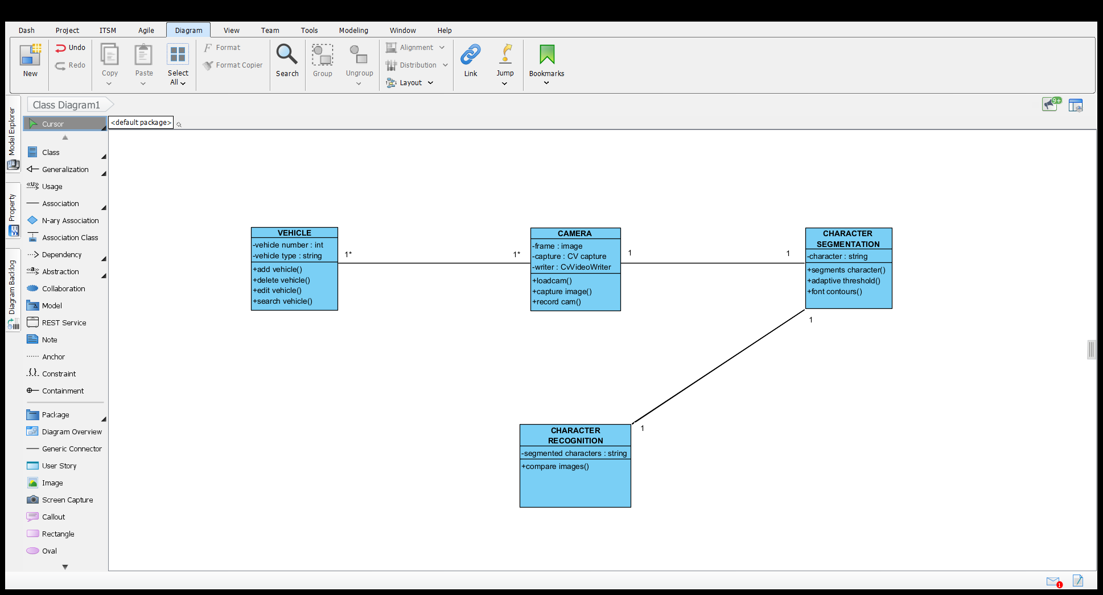
Class diagram:

Slide 13
MODULES:
Step 1: Detection of vehicle
Step 2: Capture of image
Step 3: Pre processing
Step 4: Character Segmentation
Step 5: Character recognition

Slide 14
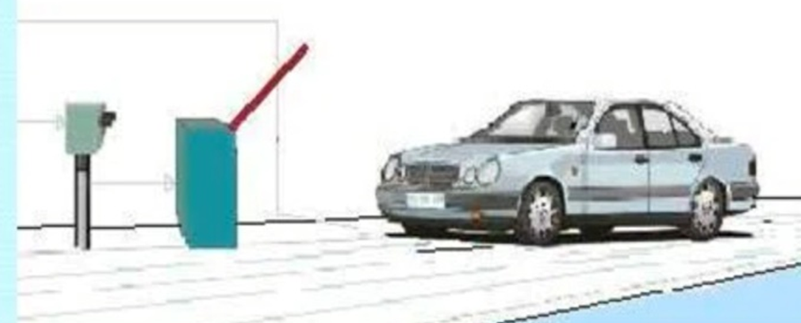
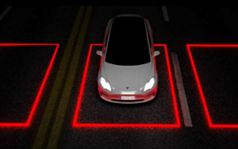
1) Detection of vehicle
The process starts when the vehicle approaches the area i.e (toll)
When the vehicle steps over the magnetic loop detector , the detector senses the car and that it will send the signal to the ANPR unit.

Slide 15
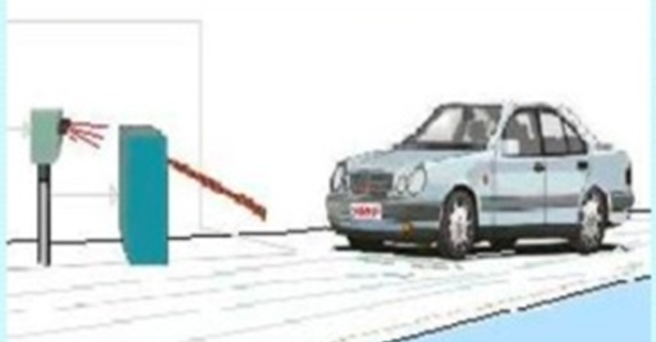

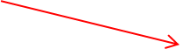

2) Capture of image
The ANPR unit gets activate and it captures the picture of front and rear number plates using the ANPR camera.
The camera uses the Infra Red IR light spectrum which produces an illumination.
The illumination used is IR because it is invisible to the driver.

Slide 16
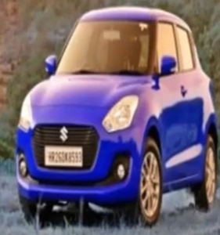
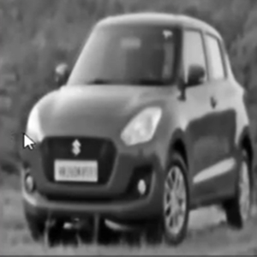
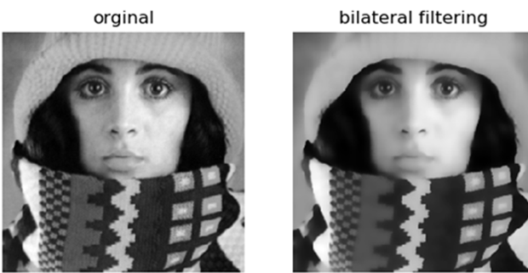



3) Pre-processing
Once after the image is captured by camera the image is converted into gray scale using bilateral filter.
The bilateral filter is used for smoothening image and reducing noise, while preserving the edges.
example:

Slide 17
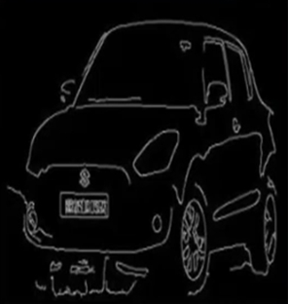


When the image is in gray scale , using canny edge detector the edge detection is done using multi stage algorithm.
Example:

Slide 18
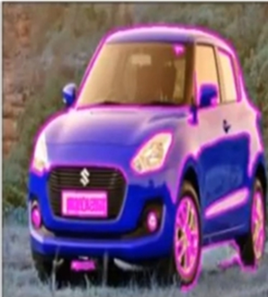

Then after edge detection, using contour detection the border of the object i.e (car) is mapped

Slide 19
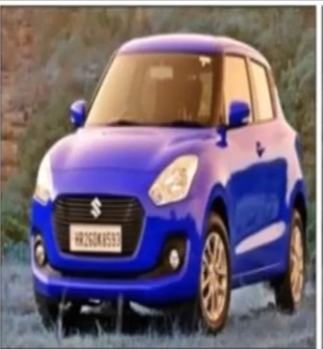
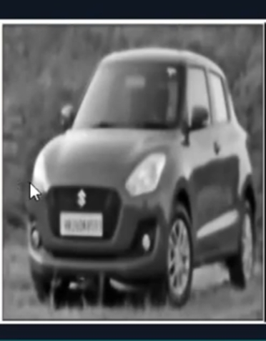
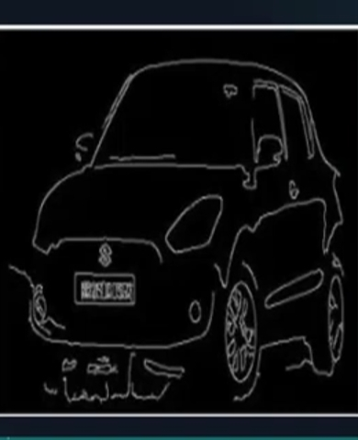

GRAY SCALE IMAGE
EDGE DETECTION
CONTOUR MAPPING
CAR IMAGE

Slide 20
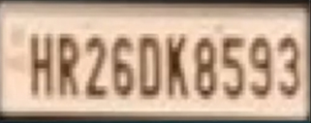

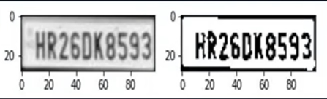

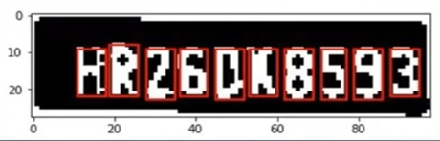

4) Character segmentation
Clipping of number plate area is done in such a way that only the number plate area is extracted.
The condition that width =5%-15%, length =35%-60%.after the condition is satisfied the character is segmented and resized to 20*20 and are ready for testing.
binarized imaged (two image in black and white)
resized to 20*20
HR 26D8593

Slide 21

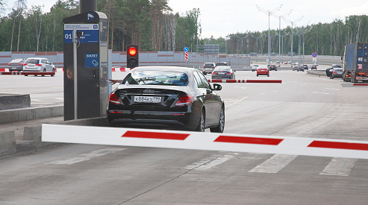
The ANPR unit analyze the image with different image processing software.
It checks if the vehicle appears on a predefined list of authorized cars and if found ,it signals to open the gate i.e it compare each character with the templates which is already stored in the software. If both the templates get matches it allows the vehicle to pass by opening the barrier ,after passing the gate the detector closes the gate and wait for the next vehicle to approach the area.

Slide 22
PERFORMANCE EVALUATION:
The success of the number plate detection and the OCR very much depend on the lighting conditions.
The normal daytime allows for at least 1/500 – 1/125 shutter speed at ISO64, which is enough to catch a decent view of a number plate in a suburban area.
1/350 is probably the lower limit for an 80kmh zone.
The slower the shutter speed, the more smudged the images appear.

Slide 23
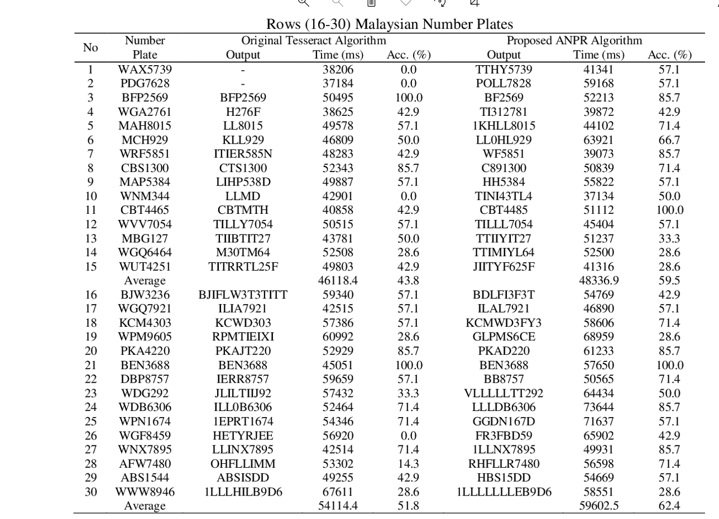

Slide 24
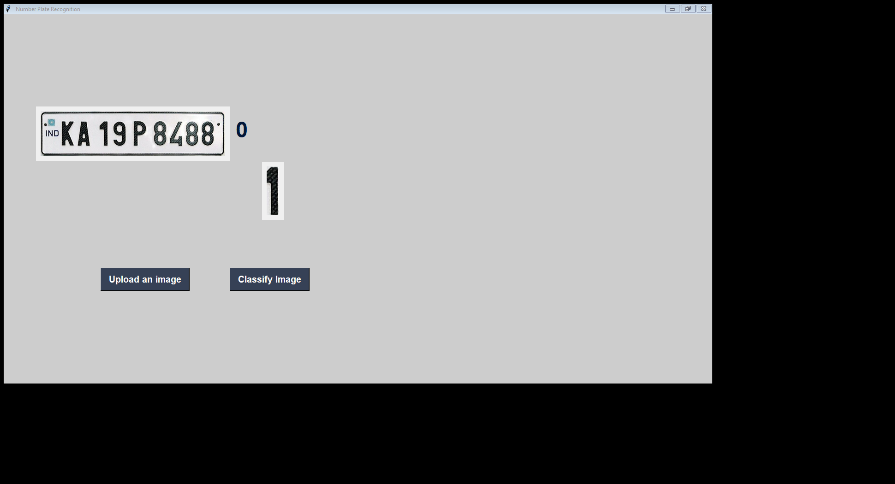
SCREENSHOTS:

Slide 25
CONCLUSION:
Therefore ANPR system plays a vital role for identifying the authorized vehicle which can save time and human efforts . The toll will not be open if the vehicle is not authorized . It gives accurate result when compared to other methods.

Slide 26
REFERENCES:
A Real-time vehicle License Plate Recognition (LPR). VISL, Technion, 2003.
License Plate Reader Technology Enhances the Identification, Recovery of Stolen Vehicles. FBI. September 2011.
Algorithm for License Plate Recognition Archived 28 April 2007 at the Wayback Machine. VISL, Technion. 2002.
An Approach To License Plate Recognition. University of Calgary. 1996.
Open ALPR Benchmarks. 31 October 2017.

